Slide 1
Emulating a target trial with the g-formula
Ellie Murray
Department of Epidemiology
Novel Epi Methods, BU
March 23, 2020

Slide 2
Goals for this talk
Explanation of the target trial framework
Example target trial emulation
Explanation of the g-formula
Calculation of the g-formula for multiple time-points
Simulation-based estimation of the parametric g-formula

Slide 3
A confounding continuum
Ideal randomized controlled trial
Unbiased Intractably biased
Actual randomized controlled trials
Pragmatic randomized trials
Observational studies

Slide 4
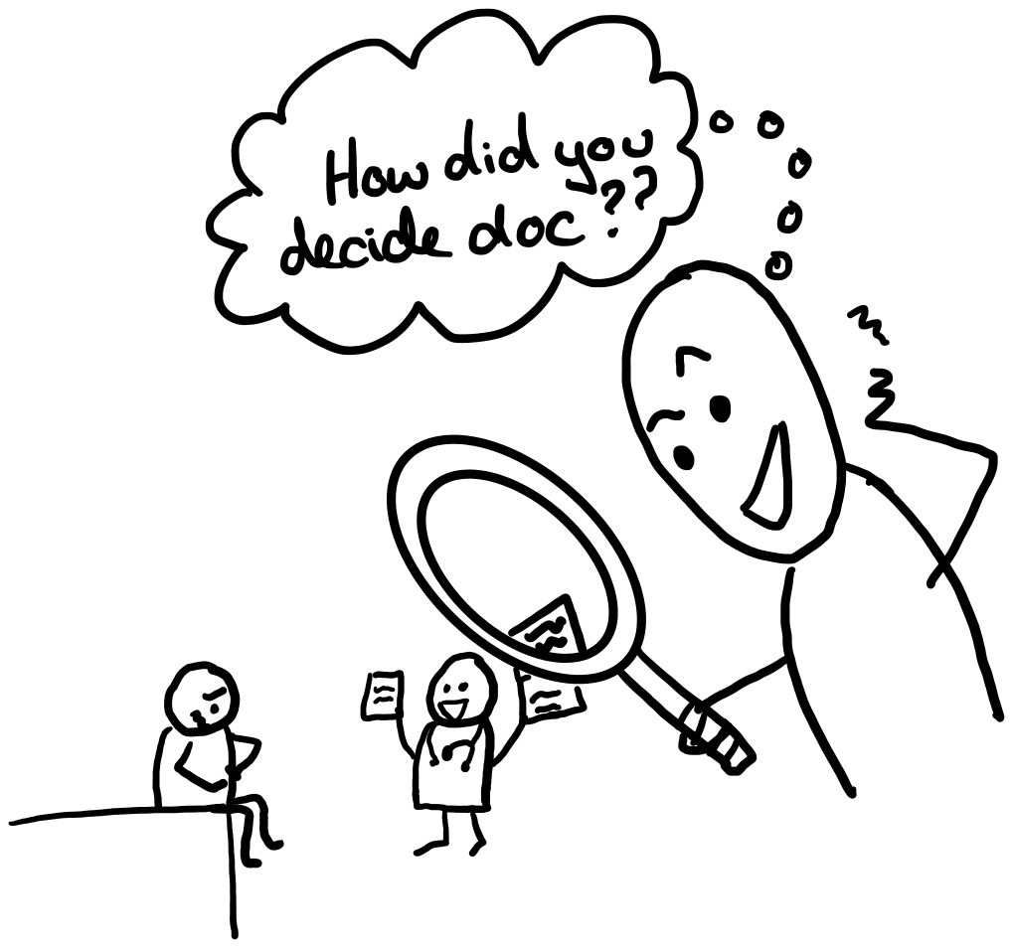
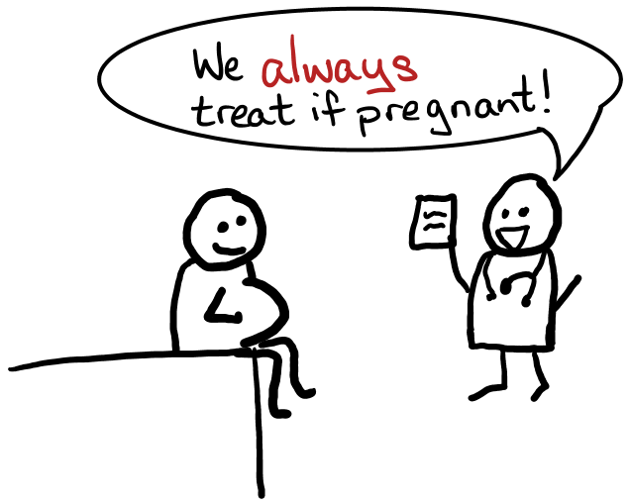

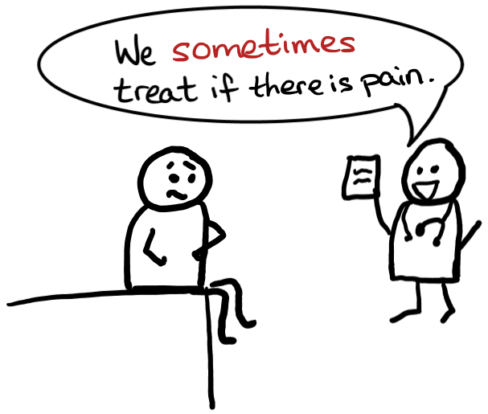




Observational studies have potential for some (relatively) unique biases
Baseline confounding
Time zero (immortal time bias)
Structural positivity violations
Ill-defined causal questions

Slide 5
Target trial framework addresses all these biases & more
Explicit definition of baseline
Explicit description of target population & inclusion/ exclusion criteria
Explicit description of well-defined interventions
Clarifies the causal question
What do we really want to know?

Slide 6
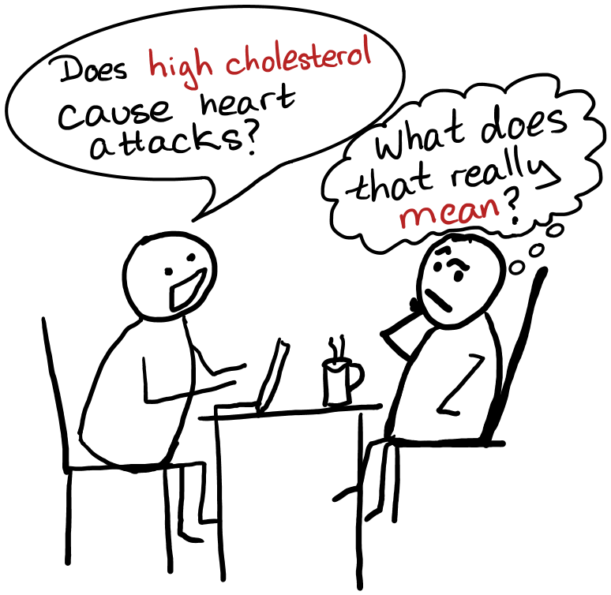
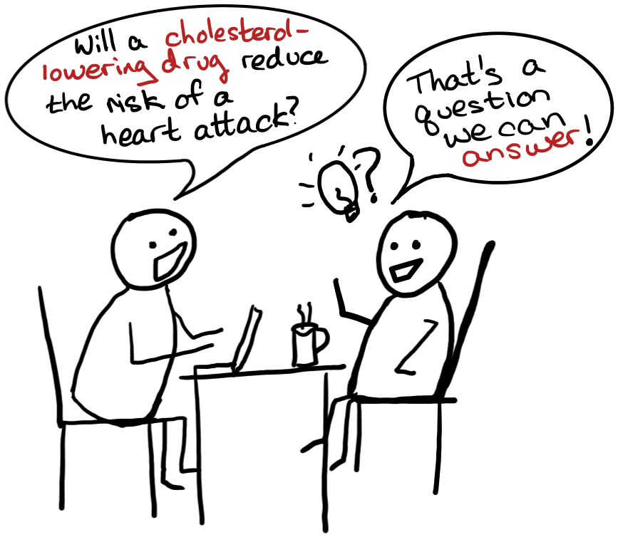
The target trial helps us ask better questions
Are we asking a specific enough question to get an answer we can understand?
Will our question guide decision making?

Slide 7





Why are well-defined interventions important?
When there are multiple possible ‘interventions’ and we don’t specify one, our answer is a weighted average of all interventions but we don’t know the weights

Slide 8
Why are well-defined interventions important?
But, if the intervention is ill-defined the confounding is probably also ill-defined!

Slide 9
Target trial framework also helps us identify our causal estimand (i.e. the target parameter)
Available in Randomized Trials Only
Intention-to-treat effects
Effect of randomization to treatment
Per-protocol effects: effect of treatment
Effect of initiating treatment
Effect of adhering to treatment protocol
Effect of receiving point intervention, among the ‘compliers’ (not necessarily all adherers!)
Available in Randomized Trials *and* Observational Studies
Hernan & Robins, 2016. NEJM
Notes:
Note with these definitions, we don’t need to distinguish between per-protocol versus as-treated

Slide 10
How does the target trial work?
Let’s look at some examples….

Slide 11
A sample target trial & emulation
 | Target trial | Emulation
Eligibility criteria | ≥18 years, HIV diagnosis, no hx of AIDS, treatment naïve, not pregnant | Same as trial, + confounders measured within past 3 months
Treatment strategies | Initiate ART immediately, when CD4 cell count below 500 cells/µl or when below 350 cells/µl | Same
Start of follow-up | Randomization | 1st time eligibility met during baseline period
End of follow-up | Earliest of event, loss to follow-up, pregnancy, or administrative censoring | Same
Outcome | Mortality risk | Same
Murray, et al. 2018. MDM

Slide 12

Goals for this talk
Explanation of the target trial framework
Example target trial emulation
Explanation of the g-formula
Calculation of the g-formula for multiple time-points
Simulation-based estimation of the parametric g-formula

Slide 13

Applying the target trial framework to a real problem
Emilsson et al. 2018. JAMA Oncol

Slide 14
Specifying the target trial
Eligibility criteria
Diagnosis of colorectal, breast, prostate, or bladder cancer in 2007-2009
Enrolled in Medicare A and B during 12 months
No statins for at least 6 months
Treatment strategies
Initiation of any statin at any dose within six months after cancer diagnosis.
No initiation of statins.
Emilsson et al. 2018. JAMA Oncol

Slide 15
Specifying the target trial
Outcomes
Cancer-specific and all-cause mortality.
Follow-up
From cancer diagnosis until death, loss to follow-up (HMO enrollment), or 31 Dec 2011, whichever comes first
Per-protocol analysis
Censoring at deviation from assigned strategy
IP weighting to adjust for selection bias due to censoring
Emilsson et al. 2018. JAMA Oncol

Slide 16
Censoring at non-adherence
Statin initiation within 6 months
Censoring at month 6 if no initiation of statins
No statin initiation
Censoring at any time if initiation of statins
Start of follow-up
Cancer diagnosis
End of follow-up
Death, loss of follow-up, Event or administrative
IPW for statin initiation
Emilsson et al. 2018. JAMA Oncol

Slide 17
Previous studies did not emulate a target trial
 | HR (95% CI)
 | Cancer-Specific mortality | All-Cause Mortality
Category 1 Statin Users vs. Nonusers during Follow-up (Risk of Immortal-Time Bias)
Pooled estimate | 0.35 (0.27-0.44) | 0.39 (0.33-0.45)
Category 2 Prevalent Statin Users vs. Non-Users at Cancer Diagnosis (Risk of Prevalent-User/ Selection Bias)
Pooled estimate | 0.77 (0.64-0.89) | 0.78 (0.67-0.90)
Category 3 Mixed Prevalent and Incident Statin Users vs. Nonusers (Risk of Prevalent-user/ Selection Bias)
Pooled estimate | 0.59 (0.32-1.06) | 0.84 (0.71-0.99)
Overall pooled estimate | 0.73 (0.58-0.88) | 0.69 (0.55-0.84)
Emilsson et al. 2018. JAMA Oncol
Notes:
In addition there were several other studies using different lag times that we excluded as their interpretation does not correlate to a relevant target trial

Slide 18
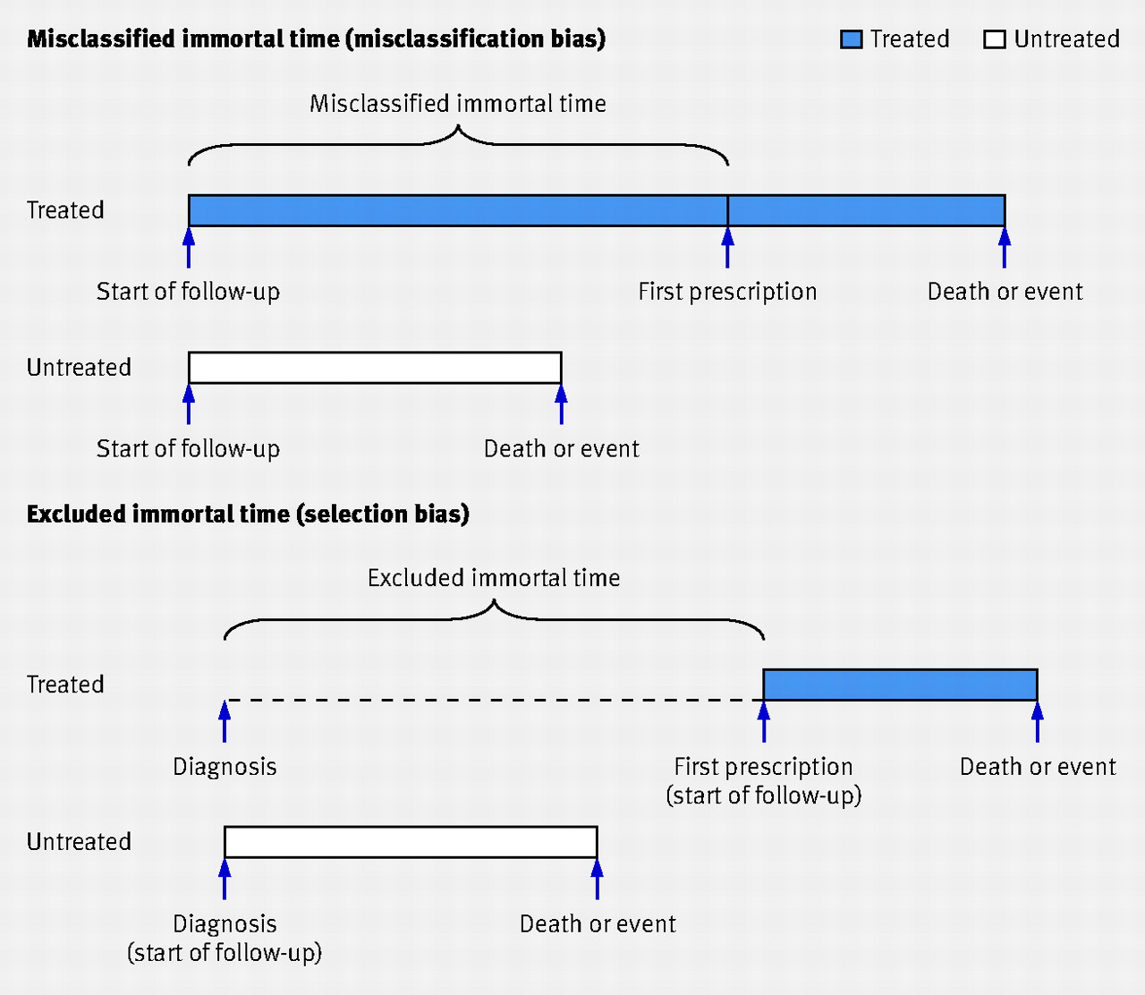

Fig 1 Immortal time bias is introduced in cohort studies when the period of immortal time is either incorrectly attributed to the treated group through a time fixed analysis (top) or excluded from the analysis because the start of follow-up for the treated group is defined by the start of treatment and is, by design, later than that for the untreated group (bottom).
Linda E Lévesque et al. BMJ 2010;340:bmj.b5087
©2010 by British Medical Journal Publishing Group
Notes:
Fig 1 Immortal time bias is introduced in cohort studies when the period of immortal time is either incorrectly attributed to the treated group through a time fixed analysis (top) or excluded from the analysis because the start of follow-up for the treated group is defined by the start of treatment and is, by design, later than that for the untreated group (bottom)‏

Slide 19
Adjustment variables
Baseline
sex, cancer stage, race, year of diagnosis, marriage status, Charlson score, a composite measure of cardiovascular disease, tobacco use, obesity, depression, hyperlipidemia, hypertension and anemia
Post-baseline
surgery, radiotherapy, chemotherapy, Charlson score, a composite measure of cardiovascular disease, tobacco use, obesity, depression, hyperlipidemia, hypertension and anemia
Emilsson et al. 2018. JAMA Oncol

Slide 20
Emulating the target trial
Use same
eligibility criteria, treatment strategies, outcome, follow-up, analysis
as the target trial
Cloning
At baseline, all individuals are assigned to both strategies by replicating them in the database
Emilsson et al. 2018. JAMA Oncol

Slide 21
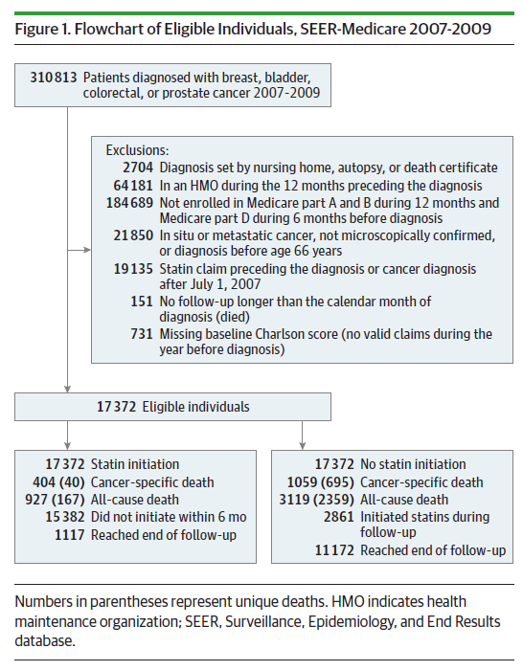
Emilsson et al. 2018. JAMA Oncol

Slide 22
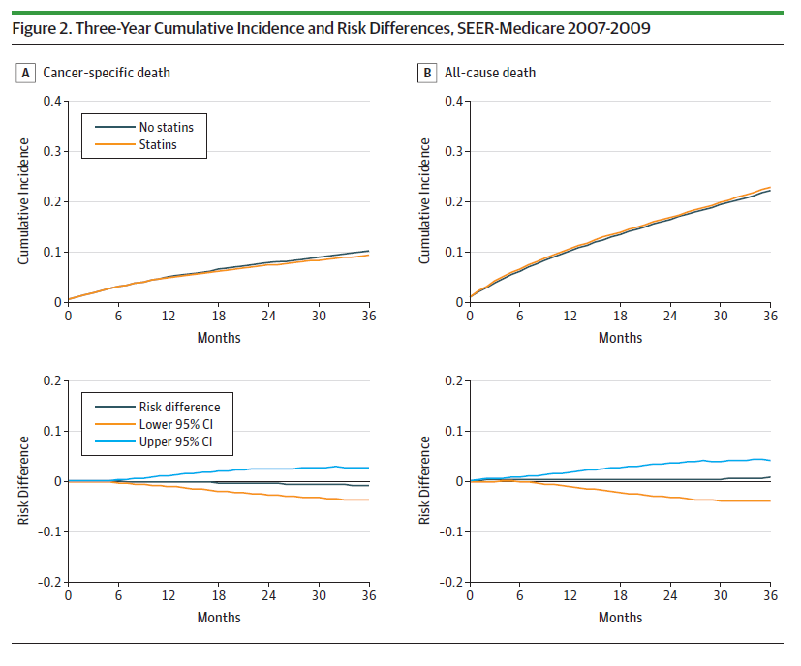
Emilsson et al. 2018. JAMA Oncol

Slide 23
Hazard ratio (95% CI)
Cancer specific death 1.00 (0.88-1.15)
All-cause death 1.07 (0.93-1.21)
Emilsson et al. 2018. JAMA Oncol

Slide 24
Advantages of explicitly emulating a target trial
The intervention is well-defined (specifically in terms of initiation time)
No selection bias
NO prevalent users vs non users at baseline
No immortal time bias
NO initiators at some point during the follow-up (alive until initiation) vs non initiators
Assessment of survival from cancer diagnosis can generate absolute risks
Emilsson et al. 2018. JAMA Oncol

Slide 25
Goals for this talk
Explanation of the target trial framework
Example target trial emulation
Explanation of the g-formula
Calculation of the g-formula for multiple time-points
Simulation-based estimation of the parametric g-formula

Slide 26
Study population
1629 cigarette smokers
Aged 25-74 years when interviewed in 1971-75 (baseline)
Interviewed again in 1982
Known sex, age, race, weight, height, education, alcohol use, and smoking intensity at both baseline and follow-up visits, and who answered the general medical history questionnaire at baseline
Hernán & Robins 2020. Causal Inference: What If. Boca Raton: Chapman & Hall/CRC
https://www.hsph.harvard.edu/miguel-hernan/causal-inference-book/

Slide 27
Key variables
Treatment A | Quit smoking between baseline and 1982 (1: yes, 0: no)
Continuous outcome Y | Weight gain (weight in 1982 minus baseline weight), kg
Dichotomous outcome D | Death by 1992 (1: yes, 0: no) Available for 1566 individuals
Potential confounders L | Measured at baseline (pre-treatment) Examples: age, sex, race, alcohol use…

Slide 28
Causal question of interest
What would the difference in mean weight change have been in 1992 if everyone had quit smoking in 1981 versus if everyone had not quit smoking in 1981?
This is the average causal effect E[Y^{a=1}] − E[Y^{a=0}] on the additive scale

Slide 29
The average causal effect E[Y^{a=1}] − E[Y^{a=0}]
The effect that would be estimated in an ideal randomized trial of smoking cessation
The unconditional (marginal) effect in the population, not the effect conditional on any covariates

Slide 30
What if our study were an ideal randomized experiment…
… in which individuals had been randomly assigned to either “quit smoking” or “remain as smokers”?
and adhered to their assignment
In our study population, we get:
25.7% assigned to smoking cessation
403/1566
74.3% assigned to no smoking cessation
1163/1566

Slide 31
If this were an ideal randomized experiment…
… in which individuals had been randomly assigned to either “quit smoking” or “remain as smokers”
Then there is no confounding
We can estimate E[Y^{a=1}] using the average outcome in the treated Ê[Y|A=1]
We can estimate E[Y^{a=0}] using the average outcome in the treated Ê[Y|A=0]

Slide 32
Sample average
Average weight gain in the treated
Ê[Y|A=1] = 4.5 kg
Average weight gain in the untreated
Ê[Y|A=0] = 2.0 kg
Difference Ê[Y|A=1] − Ê[Y|A=0]
2.5 kg (95% CI: 1.7, 3.4)
A valid estimate of the average causal effect if the study were a randomized experiment

Slide 33
Now, what if our study were an ideal randomized experiment…
… in which subjects had been randomly assigned to “quit smoking” or “remain as smokers” with a different probability according to their age?
Randomization is conditional on age group, rather than unconditional (or marginal)
Probability of being assigned to smoking cessation is
33.3% if age>50 years (L=1)
22.5% if age≤ 50 years (L=0)

Slide 34
Conditional randomization creates confounding
Younger people are less likely to quit smoking
By design (conditional randomization)
Younger people gain more weight on average
Weight gain (kg) by smoking cessation status
Quitters: 2.1 in older vs. 6.1 in younger
Non-quitters: -0.8 in older vs 3.0 in younger
Confounding bias because smoking cessation is associated with older age and therefore with less weight gain
Hernán & Robins 2020. Causal Inference: What If. Boca Raton: Chapman & Hall/CRC
https://www.hsph.harvard.edu/miguel-hernan/causal-inference-book/

Slide 35
Conditional randomization requires adjustment
The unadjusted difference Ê[Y|A=1]− Ê[Y|A=0] = 2.5 will make smoking cessation look better because
The average outcome in the treated Ê[Y|A=1] is less than E[Y^{a=1}]
The average outcome in the untreated Ê[Y|A=0] is greater than E[Y^{a=0}]
Hernán & Robins 2020. Causal Inference: What If. Boca Raton: Chapman & Hall/CRC
https://www.hsph.harvard.edu/miguel-hernan/causal-inference-book/

Slide 36
Adjusting for confounding by age via standardization
We need to estimate E[Y^{a=1}] and E[Y^{a=0}]

Slide 37
First: E[Y^{a=1}]
E[Y^{a=1}] is a weighted average of the corresponding means in
Older individuals E[Y^{a=1}|L=1]
Younger individuals E[Y^{a=1}|L=0]
with weights equal to the proportions of younger and older individuals
Pr[L=1], Pr[L=0]
Hernán & Robins 2020. Causal Inference: What If. Boca Raton: Chapman & Hall/CRC
https://www.hsph.harvard.edu/miguel-hernan/causal-inference-book/

Slide 38
Counterfactual mean
under treatment is a weighted average
E[Y^{a=1}]
Hernán & Robins 2020. Causal Inference: What If. Boca Raton: Chapman & Hall/CRC
https://www.hsph.harvard.edu/miguel-hernan/causal-inference-book/

Slide 39
Counterfactual mean
under treatment is a weighted average
Proportion of
older people
Proportion of
younger people
E[Y^{a=1}] =
E[Y^{a=1}|L=1] ×
weight for older
+ E[Y^{a=1}|L=0] ×
weight for younger
counterfactual mean
in the older
counterfactual mean
in the younger
Hernán & Robins 2020. Causal Inference: What If. Boca Raton: Chapman & Hall/CRC
https://www.hsph.harvard.edu/miguel-hernan/causal-inference-book/

Slide 40
Counterfactual mean
under treatment is a weighted average
Proportion of
older people
Proportion of
younger people
E[Y^{a=1}] =
E[Y^{a=1}|L=1] ×
Pr[L=1]
+ E[Y^{a=1}|L=0] ×
Pr[L= 0]
counterfactual mean
in the older
counterfactual mean
in the younger
Hernán & Robins 2020. Causal Inference: What If. Boca Raton: Chapman & Hall/CRC
https://www.hsph.harvard.edu/miguel-hernan/causal-inference-book/

Slide 41
Counterfactual mean
under treatment in
older people
E[Y^{a=1}] =
E[Y^{a=1}|L=1] ×
Pr[L=1]
+ E[Y^{a=1}|L=0] ×
Pr[L= 0]
is the mean in the
treated among
older people
Because the treated and the untreated are exchangeable conditional on age group
Hernán & Robins 2020. Causal Inference: What If. Boca Raton: Chapman & Hall/CRC
https://www.hsph.harvard.edu/miguel-hernan/causal-inference-book/

Slide 42
Counterfactual mean
under treatment in
older people
Counterfactual mean
under treatment in
younger people
E[Y^{a=1}] =
E[Y|L=1, A=1] ×
Pr[L=1]
+ E[Y^{a=1}|L=0] ×
Pr[L= 0]
is the mean in the
treated among
older people
is the mean in the
treated among
younger people
Because the treated and the untreated are exchangeable conditional on age group
Hernán & Robins 2020. Causal Inference: What If. Boca Raton: Chapman & Hall/CRC
https://www.hsph.harvard.edu/miguel-hernan/causal-inference-book/

Slide 43
Counterfactual mean
under treatment in
older people
Counterfactual mean
under treatment in
younger people
E[Y^{a=1}] =
E[Y|L=1, A=1] ×
Pr[L=1]
+ E[Y|L=0, A=1] ×
Pr[L= 0]
is the mean in the
treated among
older people
is the mean in the
treated among
younger people
Because the treated and the untreated are exchangeable conditional on age group
Hernán & Robins 2020. Causal Inference: What If. Boca Raton: Chapman & Hall/CRC
https://www.hsph.harvard.edu/miguel-hernan/causal-inference-book/

Slide 44
Counterfactual mean
under treatment
mean standardized to the age group distribution in the population
E[Y^{a=1}] =
E[Y|L=1, A=1] ×
Pr[L=1]
+ E[Y|L=0, A=1] ×
Pr[L= 0]
= Σ_{l=1,0} E[Y|L=l, A=1] × Pr[L=l]
more compact notation
E[Y^{a=0}] =
Σ_{l=1,0} E[Y|L=l, A=0] × Pr[L=l]
Counterfactual mean
under no treatment
Hernán & Robins 2020. Causal Inference: What If. Boca Raton: Chapman & Hall/CRC
https://www.hsph.harvard.edu/miguel-hernan/causal-inference-book/

Slide 45
This is the g-formula!
A generalization (g) of standardization to time-varying settings
An equation (formula) that relates the observational data to the counterfactual data
E[Y^{a=1}] =
Σ_{l=1,0} E[Y|L=l, A=1] × Pr[L=l]
E[Y^{a=0}] =
Σ_{l=1,0} E[Y|L=l, A=0] × Pr[L=l]

Slide 46
Estimating the average causal effect E[Y^{a=1}] − E[Y^{a=0}]
We can estimate the standardized means
without models
Sample averages for outcome means E[Y|A, L]
Sample proportions for confounder prevalence Pr[L=l]
with models

Slide 47
Estimation with a linear model: E[Y|A, L]= θ0 + θ1 A + θ2 L + θ3 AL

Slide 48
SAS CODE
/*Create some new variables*/
data nhefs; set nhefs;
older = .; if age > 50 then older = 1; else if .< age le 50 then older = 0;
qsmkolder = qsmk*older;
run;
/*Fit a model for weight given smoking cessation and age: E[Y|A, L]= θ0 + θ1 A + θ2 L + θ3 AL*/
proc genmod data = nhefs;
model wt82_71 = qsmk older qsmkolder ;
run; quit;

Slide 49
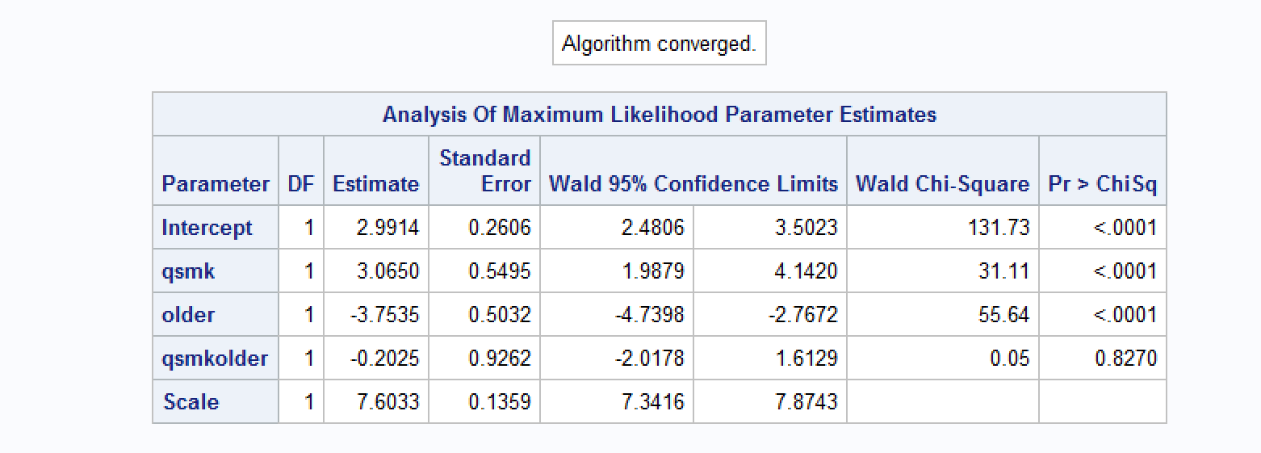
SAS Output

Slide 50
Estimation with a linear model: E[Y|A, L]= θ0 + θ1 A + θ2 L + θ3 AL
Interpretation of parameters
E[Y|A=0, L=0] = θ₀ , E[Y|A=0, L=1] = θ₀ + θ₂
E[Y|A=1, L=0] = θ₀ + θ₁ , E[Y|A=1, L=1] = θ₀ + θ₁ + θ₂ + θ₃
Use parameter estimates to calculate
Ê[Y|A=0, L=0] = 2.99
Ê[Y|A=0, L=1] = 2.99 + (– 3.75) = −0.76
Ê[Y|A=1, L=0] = 2.99 + 3.07 = 6.06
Ê[Y|A=1, L=1] = 2.99 + (-3.75) + 3.07 + (-0.20) =2.10

Slide 51
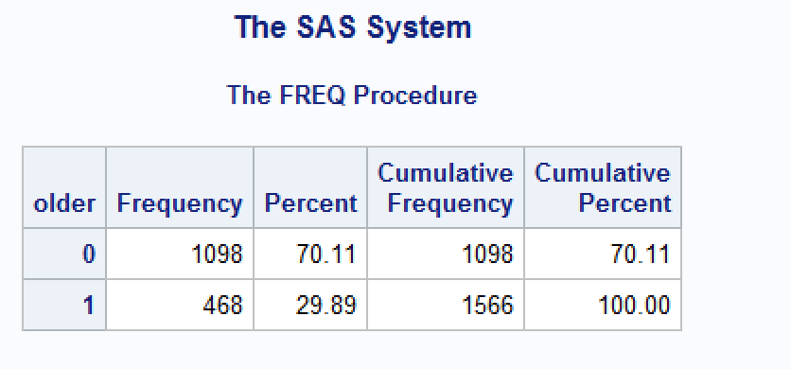
We also need the prevalence of L=0 & L=1
proc freq data = nhefs;
where cens = 0;
tables older;
run;

Slide 52
Standardization by hand: Model 1
Standardized average in the treated
2.10 × 0.2989 + 6.06 × 0.7011 = 4.87
Standardized average in the untreated
(−0.76) × 0.2989 + 2.99 × 0.7011 = 1.87
Difference: 3.00 kg
causal interpretation if treatment had been randomized conditional on age group

Slide 53
Estimation with a linear model, and assumptions: E[Y|A, L]= θ0 + θ1 A + θ2 L
SAS Code:
/*Fit a model for weight given smoking cessation and age: E[Y|A, L]= θ0 + θ1 A + θ2 L */
proc genmod data = nhefs;
model wt82_71 = qsmk older;
run; quit;

Slide 54
Estimation with a linear model, and assumptions: E[Y|A, L]= θ0 + θ1 A + θ2 L
Interpretation of parameters
E[Y|A=0, L=0] = θ₀ , E[Y|A=0, L=1] = θ₀ + θ₂
E[Y|A=1, L=0] = θ₀ + θ₁ , E[Y|A=1, L=1] = θ₀ + θ₁ + θ₂
Use parameter estimates to calculate
Ê[Y|A=0, L=0] = 3.01
Ê[Y|A=0, L=1] = −0.81
Ê[Y|A=1, L=0] = 6.00
Ê[Y|A=1, L=1] = 2.19
Try it yourself!

Slide 55
Standardization by hand: Model 2
Try it yourself!
Try it yourself!
Remember:
Ê[Y|A=0, L=0] = 3.01 P[L=0]=0.7011
Ê[Y|A=0, L=1] = −0.81 P[L=1]=0.2989
Ê[Y|A=1, L=0] = 6.00
Ê[Y|A=1, L=1] = 2.19
TRY IT:
Standardized average in the treated:
Standardized average in the untreated:
Difference:

Slide 56
What if randomization had been conditional on 2 covariates L₁, L₂?
Consider two dichotomous variables
L₁ − Age group: older than 50 (1), 50 or less (0)
L₂ − Sex: Women (1), Men (0)
Suppose that treatment was randomly assigned with a different probability in each of the following strata
Younger men (L₁=0, L₂=0)
Younger women (L₁=0, L₂=1)
Older men (L₁=1, L₂=0)
Older women (L₁=1, L₂=1)

Slide 57
Standardized mean in the treated
To standardize (and adjust for confounding) we need to
compute the stratum-specific sample average E[Y|A=a, L₁, L₂] in each of the 4 combinations of values of (L₁, L₂)
compute the prevalence of each of the 4 strata (L₁, L₂)
compute the weighted average of the 4 stratum-specific means:
E[Y|A=a, L₁=0, L₂=0]×Pr[L₁=0, L₂=0] +
E[Y|A=a, L₁=0, L₂=1]×Pr[L₁=0, L₂=1] +
E[Y|A=a, L₁=1, L₂=0]×Pr[L₁=1, L₂=0] +
E[Y|A=a, L₁=1, L₂=1]×Pr[L₁=1, L₂=1]

Slide 58
Standardization by hand: 2 covariates SAS CODE
data nhefs; set nhefs; qsmksex = sex*qsmk; sexolder = sex*older; qsmksexolder = qsmk*sex*older; run;
proc genmod data = nhefs;
model wt82_71 = qsmk older sex qsmkolder qsmksex sexolder qsmksexolder;
run;
quit;
proc freq data = nhefs;
where cens = 0;
tables sex*older;
run;

Slide 59
Standardization by hand: 2 covariates
Remember:
E[Y|A=1, L₁=0, L₂=0]= E[Y|A=0, L₁=0, L₂=0] = Pr[L₁=0, L₂=0] =
E[Y|A=1, L₁=0, L₂=1] = E[Y|A=0, L₁=0, L₂=1] = Pr[L₁=0, L₂=1] =
E[Y|A=1, L₁=1, L₂=0] = E[Y|A=0, L₁=1, L₂=0] = Pr[L₁=1, L₂=0] =
E[Y|A=1, L₁=1, L₂=1] = E[Y|A=0, L₁=1, L₂=1] = Pr[L₁=1, L₂=1] =
TRY IT AT HOME:
Standardized average in the treated:
Standardized average in the untreated:
Difference:

Slide 60
What if randomization had been conditional on 10 covariates?
To standardize (and adjust for confounding), we need to
compute the stratum-specific sample average E[Y|A=1, L₁, L₂] in each of the 2¹⁰ = 1024 combinations of values of (L₁, L₂)
compute the prevalence of each of the 1024 strata (L₁, L₂)
compute the weighted average of the 1024 stratum-specific means
This is often the situation in observational studies
many covariates proposed to adjust for confounding

Slide 61

Too much work to calculate by hand! Instead we use a model
For example, fit model with linear+quadratic terms for continuous variables and no product terms
Then sum over all combinations of values of L
The sum is replaced by an integral when there is high-dimensional data
The integral can be approximated by using the empirical distribution of the confounders

Slide 62
A trick to standardizing without calculating probabilities
id | rand | sex | age | race | death
1 | 0 | 0 | 65 | 1 | 0
2 | 1 | 0 | 58 | 1 | 1
3 | 0 | 1 | 67 | 1 | 1
4 | 1 | 0 | 54 | 0 | 0
5 | 0 | 1 | 48 | 0 | 0
1. Original data
Notes:
We’re going to make two additional copies of the data

Slide 63
A trick to standardizing without calculating probabilities
id | rand | sex | age | race | death | Interv
1 | 0 | 0 | 65 | 1 | 0 | 0
2 | 1 | 0 | 58 | 1 | 1 | 0
3 | 0 | 1 | 67 | 1 | 1 | 0
4 | 1 | 0 | 54 | 0 | 0 | 0
5 | 0 | 1 | 48 | 0 | 0 | 0
1 | 0 | 0 | 65 | 1 | 0 | 1
2 | 1 | 0 | 58 | 1 | 1 | 1
3 | 0 | 1 | 67 | 1 | 1 | 1
4 | 1 | 0 | 54 | 0 | 0 | 1
5 | 0 | 1 | 48 | 0 | 0 | 1
Original data
Copy data
Notes:
We’re going to make two additional copies of the data

Slide 64
A trick to standardizing without calculating probabilities
id | rand | sex | age | race | death | Interv
1 | 0 | 0 | 65 | 1 | 0 | 0
2 | 1 | 0 | 58 | 1 | 1 | 0
3 | 0 | 1 | 67 | 1 | 1 | 0
4 | 0 | 0 | 54 | 0 | 0 | 0
5 | 0 | 1 | 48 | 0 | 0 | 0
1 | 0 | 0 | 65 | 1 | 0 | 1
2 | 1 | 0 | 58 | 1 | 1 | 1
3 | 0 | 1 | 67 | 1 | 1 | 1
4 | 0 | 0 | 54 | 0 | 0 | 1
5 | 0 | 1 | 48 | 0 | 0 | 1
1 | 0 | 0 | 65 | 1 | 0 | -1
2 | 1 | 0 | 58 | 1 | 1 | -1
3 | 0 | 1 | 67 | 1 | 1 | -1
4 | 0 | 0 | 54 | 0 | 0 | -1
5 | 0 | 1 | 48 | 0 | 0 | -1
Original data
Copy data
Repeat as many times as there are exposure levels (create a unique tag for each set of copies)
Notes:
We’re going to make two additional copies of the data

Slide 65
A trick to standardizing without calculating probabilities
id | rand | sex | age | race | death | Interv
1 | 0 | 0 | 65 | 1 | . | 0
2 | 1 | 0 | 58 | 1 | . | 0
3 | 0 | 1 | 67 | 1 | . | 0
4 | 0 | 0 | 54 | 0 | . | 0
5 | 0 | 1 | 48 | 0 | . | 0
1 | 0 | 0 | 65 | 1 | . | 1
2 | 1 | 0 | 58 | 1 | . | 1
3 | 0 | 1 | 67 | 1 | . | 1
4 | 0 | 0 | 54 | 0 | . | 1
5 | 0 | 1 | 48 | 0 | . | 1
1 | 0 | 0 | 65 | 1 | 0 | -1
2 | 1 | 0 | 58 | 1 | 1 | -1
3 | 0 | 1 | 67 | 1 | 1 | -1
4 | 0 | 0 | 54 | 0 | 0 | -1
5 | 0 | 1 | 48 | 0 | 0 | -1
Original data
Copy data
Repeat as many times as there are exposure levels (create a unique tag for each set of copies)
Set outcome to missing in all but one set of copies
Notes:
We’re going to make two additional copies of the data

Slide 66
A trick to standardizing without calculating probabilities
id | rand | sex | age | race | death | Interv
1 | 0 | 0 | 65 | 1 | . | 0
2 | 0 | 0 | 58 | 1 | . | 0
3 | 0 | 1 | 67 | 1 | . | 0
4 | 0 | 0 | 54 | 0 | . | 0
5 | 0 | 1 | 48 | 0 | . | 0
1 | 0 | 0 | 65 | 1 | . | 1
2 | 1 | 0 | 58 | 1 | . | 1
3 | 0 | 1 | 67 | 1 | . | 1
4 | 0 | 0 | 54 | 0 | . | 1
5 | 0 | 1 | 48 | 0 | . | 1
1 | 0 | 0 | 65 | 1 | 0 | -1
2 | 1 | 0 | 58 | 1 | 1 | -1
3 | 0 | 1 | 67 | 1 | 1 | -1
4 | 0 | 0 | 54 | 0 | 0 | -1
5 | 0 | 1 | 48 | 0 | 0 | -1
Original data
Copy data
Repeat as many times as there are exposure levels (create a unique tag for each set of copies)
Set outcome to missing in all but one set of copies
Assign everyone in copy 1 to exposure level 1…
Notes:
We’re going to make two additional copies of the data

Slide 67
A trick to standardizing without calculating probabilities
id | rand | sex | age | race | death | Interv
1 | 0 | 0 | 65 | 1 | . | 0
2 | 0 | 0 | 58 | 1 | . | 0
3 | 0 | 1 | 67 | 1 | . | 0
4 | 0 | 0 | 54 | 0 | . | 0
5 | 0 | 1 | 48 | 0 | . | 0
1 | 1 | 0 | 65 | 1 | . | 1
2 | 1 | 0 | 58 | 1 | . | 1
3 | 1 | 1 | 67 | 1 | . | 1
4 | 1 | 0 | 54 | 0 | . | 1
5 | 1 | 1 | 48 | 0 | . | 1
1 | 0 | 0 | 65 | 1 | 0 | -1
2 | 1 | 0 | 58 | 1 | 1 | -1
3 | 0 | 1 | 67 | 1 | 1 | -1
4 | 0 | 0 | 54 | 0 | 0 | -1
5 | 0 | 1 | 48 | 0 | 0 | -1
Original data
Copy data
Repeat as many times as there are exposure levels (create a unique tag for each set of copies)
Set outcome to missing in all but one set of copies
Assign everyone in copy 1 to exposure level 1 and copy 2 to exposure level 2
Notes:
We’re going to make two additional copies of the data

Slide 68
A trick to standardizing without calculating probabilities
id | rand | sex | age | race | death | Interv
1 | 0 | 0 | 65 | 1 | . | 0
2 | 0 | 0 | 58 | 1 | . | 0
3 | 0 | 1 | 67 | 1 | . | 0
4 | 0 | 0 | 54 | 0 | . | 0
5 | 0 | 1 | 48 | 0 | . | 0
1 | 1 | 0 | 65 | 1 | . | 1
2 | 1 | 0 | 58 | 1 | . | 1
3 | 1 | 1 | 67 | 1 | . | 1
4 | 1 | 0 | 54 | 0 | . | 1
5 | 1 | 1 | 48 | 0 | . | 1
1 | 0 | 0 | 65 | 1 | 0 | -1
2 | 1 | 0 | 58 | 1 | 1 | -1
3 | 0 | 1 | 67 | 1 | 1 | -1
4 | 0 | 0 | 54 | 0 | 0 | -1
5 | 0 | 1 | 48 | 0 | 0 | -1
Run a model for the outcome given randomization and any baseline covariates of interest
Model will be fit in this original data only, since has no missing outcome values
Notes:
We’re going to make two additional copies of the data

Slide 69
A trick to standardizing without calculating probabilities
id | rand | sex | age | race | death | Interv | pr_d
1 | 0 | 0 | 65 | 1 | . | 0 | #
2 | 0 | 0 | 58 | 1 | . | 0 | #
3 | 0 | 1 | 67 | 1 | . | 0 | #
4 | 0 | 0 | 54 | 0 | . | 0 | #
5 | 0 | 1 | 48 | 0 | . | 0 | #
1 | 1 | 0 | 65 | 1 | . | 1 | #
2 | 1 | 0 | 58 | 1 | . | 1 | #
3 | 1 | 1 | 67 | 1 | . | 1 | #
4 | 1 | 0 | 54 | 0 | . | 1 | #
5 | 1 | 1 | 48 | 0 | . | 1 | #
1 | 0 | 0 | 65 | 1 | 0 | -1 | #
2 | 1 | 0 | 58 | 1 | 1 | -1 | #
3 | 0 | 1 | 67 | 1 | 1 | -1 | #
4 | 0 | 0 | 54 | 0 | 0 | -1 | #
5 | 0 | 1 | 48 | 0 | 0 | -1 | #
Run a model for the outcome given randomization and any baseline covariates of interest
Estimate predicted probability of the outcome from your model for every real & copied observation
Notes:
We’re going to make two additional copies of the data

Slide 70
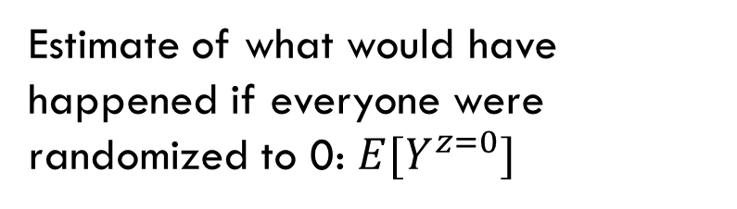
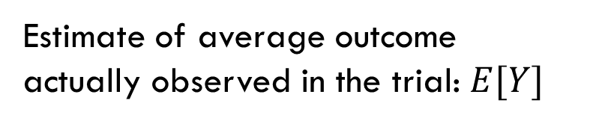
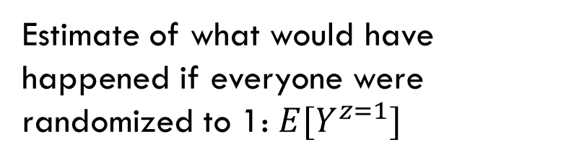
A trick to standardizing without calculating probabilities
id | rand | sex | age | race | death | Interv | pr_d
1 | 0 | 0 | 65 | 1 | . | 0 | #
2 | 0 | 0 | 58 | 1 | . | 0 | #
3 | 0 | 1 | 67 | 1 | . | 0 | #
4 | 0 | 0 | 54 | 0 | . | 0 | #
5 | 0 | 1 | 48 | 0 | . | 0 | #
1 | 1 | 0 | 65 | 1 | . | 1 | #
2 | 1 | 0 | 58 | 1 | . | 1 | #
3 | 1 | 1 | 67 | 1 | . | 1 | #
4 | 1 | 0 | 54 | 0 | . | 1 | #
5 | 1 | 1 | 48 | 0 | . | 1 | #
1 | 0 | 0 | 65 | 1 | 0 | -1 | #
2 | 1 | 0 | 58 | 1 | 1 | -1 | #
3 | 0 | 1 | 67 | 1 | 1 | -1 | #
4 | 0 | 0 | 54 | 0 | 0 | -1 | #
5 | 0 | 1 | 48 | 0 | 0 | -1 | #
Estimate of what would have happened if everyone were randomized to 0: $E[Y^{z=0}]$
Estimate of what would have happened if everyone were randomized to 1: $E[Y^{z=1}]$
Estimate of average outcome actually observed in the trial: $E[Y]$
Notes:
We’re going to make two additional copies of the data

Slide 71
SAS code: Create 3 copies
/* create a dataset with 3 copies of each subject */
data onesample ; set nhefs ; label interv= "Intervention";
interv = -1 ; output ;
interv = 0 ; /* 2nd copy: treatment =0, outcome = missing */
qsmk = 0 ;
wt82_71 = . ; output ;
interv = 1 ; /* 3rd copy: treatment =1, outcome = missing*/
qsmk = 1 ;
wt82_71 = . ; output ;
run;

Slide 72
SAS code: Estimate outcome model and output predicted values for each individual
proc genmod data = onesample;
class exercise active education;
model wt82_71 = qsmk sex race age age*age education
smokeintensity smokeyrs smokeintensity*smokeintensity smokeyrs*smokeyrs exercise active wt71 wt71*wt71
qsmk*smokeintensity
;
output out = predicted_mean p = meanY ;
run;

Slide 73
SAS code: estimate the mean of the predicted outcome within each **intervention copy**
proc means data = predicted_mean mean noprint;
class interv ;
var meanY ;
types interv ;
output out = results (keep = interv mean ) mean = mean ;
run;
proc print data = results noobs label ;
title "Parametric g-formula";
var interv mean ;
run;

Slide 74
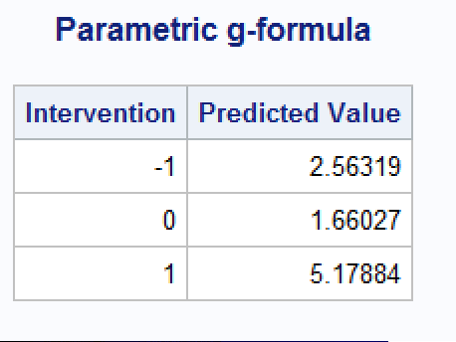

Slide 75
Parametric estimation
Estimates of standardized mean
1.7 kg in the untreated
5.2 kg in the treated
Difference: 3.5 kg
This difference would have a causal interpretation if all confounders had been included in the standardization procedure
Note the difference gets further from zero as more baseline covariates are adjusted for

Slide 76
Estimating variance:
We generally use “bootstrapping” to calculate an approximate 95% confidence interval of the difference of standardized means
Bootstrapping code is available in Chapter 13 of Causal Inference: What if (program 13.4)
The lazy statistician’s method
2.6, 4.3
Notes:
Delete footnote

Slide 77
Goals for this talk
Explanation of the target trial framework
Example target trial emulation
Explanation of the g-formula
Calculation of the g-formula for multiple time-points
Simulation-based estimation of the parametric g-formula

Slide 78
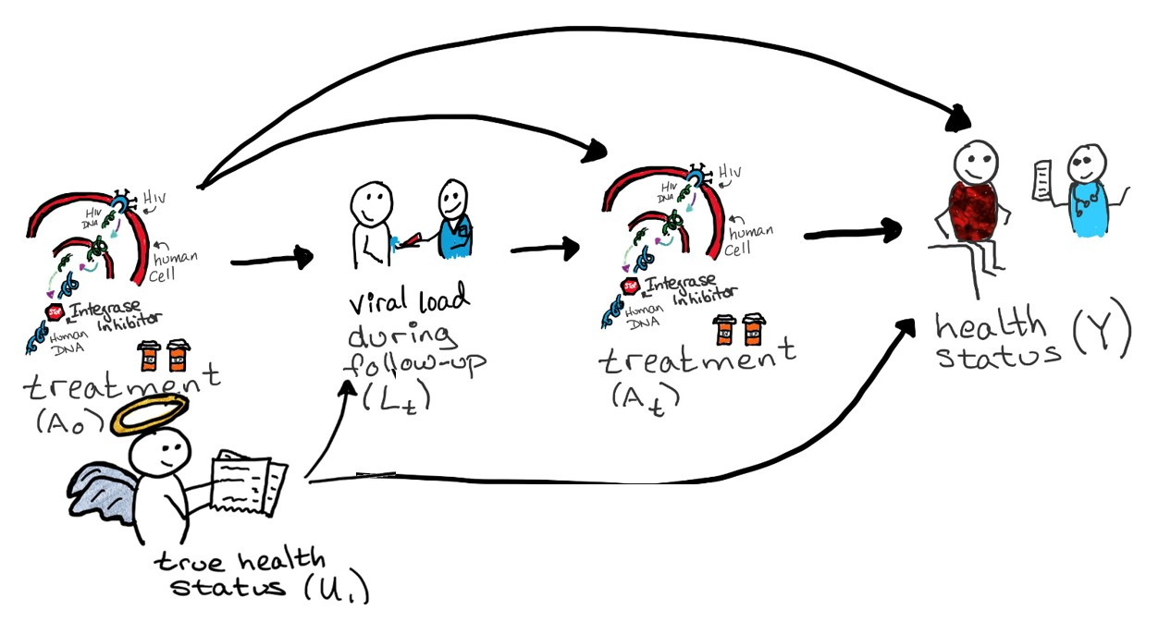
Consider the DAG:

Slide 79
What g-formula represents this DAG?
Step 1: what exchangeability criteria do we need?
Y^{a0,a1} || A₀
yes
Y^{a0,a1} || A₁ | A₀
if conditional on L_{t}

Slide 80
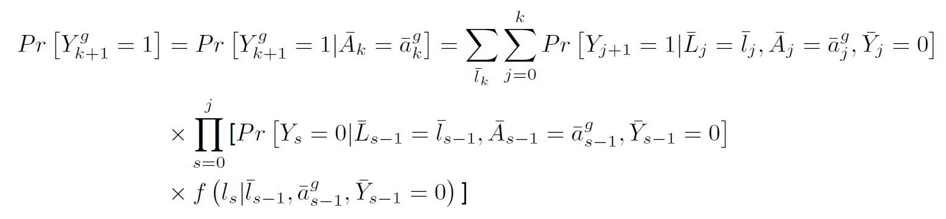
The g-formula again
For a single time point:
For multiple time points:

Slide 81

The g-formula(e) for our DAG
$P\left[Y^{a0,a1}=1\right]=\sum_{l}{P[Y=1|A_{0}=a_{0},}A_{1}=a_{1}, L=l]P[L=l|A_{0}=a_{0}$]
$=P[Y=1|A_{0}=a_{0},A_{1}=a_{1}, L=0]P[L=0|A_{0}=a_{0}$]
+$P[Y=1|A_{0}=a_{0},A_{1}=a_{1}, L=1]P[L=1|A_{0}=a_{0}$]
$P\left[Y^{a0=0,a1=0}=1\right]=\sum_{l}{P[Y=1|A_{0}=0,}A_{1}=0, L=l]P[L=l|A_{0}=0$]
$=P[Y=1|A_{0}=0,A_{1}=0, L=0]P[L=0|A_{0}=0$]
+$P[Y=1|A_{0}=0,A_{1}=0, L=1]P[L=1|A_{0}=0$]
$P\left[Y^{a0=1,a1=0}=1\right]=$
$P\left[Y^{a0=0,a1=1}=1\right]=$
$P\left[Y^{a0=1,a1=1}=1\right]=$
Try at home!

Slide 82
With multiple exposures and one outcome time point, we can hand-calculate our g-formula
Need to specify which counterfactual contrasts we actually want
Time consuming to do by hand
If we have any continuous covariates, we’ll need to use models

Slide 83
What about one exposure & multiple outcomes?
Let’s look at the g-formula for survival / failure time using the NHEFS data

Slide 84
A causal question for survival analysis
First define the counterfactual survival at each time k
if everybody had quit smoking
if nobody had quit smoking
Then the average causal effect can be defined as the difference between the survival curves overall or at particular times of interest (i.e., 10 years)

Slide 85
Review: Person-time data structure
ID | Month (k) | A | D_{k+1}
1 | 0 | 1 | 0
1 | 1 | 1 | 0
… | … | … | …
1 | 119 | 1 | 0
2 | 0 | 0 | 0
2 | 1 | 0 | 0
… | … | … | …
2 | 16 | 0 | 0
2 | 17 | 0 | 1
One row per person-month
D_{k} is the indicator of death by time k
1 if T≤k+1
0 if T>k+1
An individual has 120 rows only if she reaches the end of follow-up alive

Slide 86
Some survival analysis definitions
Survival probability: Pr[T>k]
Risk (cumulative incidence): Pr[T≤k]
All deaths between baseline and time k
Compared to the number of individuals at baseline
Discrete hazard: Pr[T=k+1|T>k]
Recent deaths occurring during interval k to k+1
Compared to the number individuals alive (and under follow-up) at k

Slide 87
Causal inference for survival analysis is difficult because
Time-varying confounding-exposure feedback
Time zero & immortal time bias
Exposures can be hard to define well
These problems are less likely with a randomized trial, but common in observational studies

Slide 88
Remember: Censoring matters
Censoring of death time may occur because of administrative end of follow-up, loss to follow-up, etc.
In the NHEFS, death time is
known for 318 subjects (values between 1 and 120 months)
administratively censored for the remaining 1,311 individuals
When censoring exits, special techniques are generally required for survival analysis

Slide 89
Standardization for survival analysis 4 steps
Parametric estimation of hazards conditional on treatment and confounders
Estimation of conditional survivals
Computation of weighted average of survivals
Estimation of variance

Slide 90

Step 1: Semi-parametric estimate
We can easily estimate the hazard ratio if we’re willing to make one assumption:
The hazard ratio is constant over follow-up
Now we can use Cox proportional hazards regression

Slide 91

Step 2: Parametric estimate
If we’re willing to make one more assumption, we can also estimate the hazard and the survival, plus the risk difference and risk ratio
The baseline hazard has a specified functional form
(here we assume quadratic)
Now we can use pooled logistic regression

Slide 92
Step #1: Parametric estimation of hazard at time k+1
Fit a pooled logistic regression model
logit Pr[D_{k+1}=1|D_{k}=0, A, L] = θ_{0,k} + θ₁A + θ₂Ak + θ₃Ak² + θ₄L
θ_{0,k} = θ₀ + θ₅k + θ₆k² is a time-varying intercept to allow the hazard to vary over time
the product terms θ₂Ak + θ₃Ak² allow the hazard ratio to vary over time
We assume exchangeability conditional on the same 9 variables L as in previous sections

Slide 93
Step #2: Estimation of conditional survival by k+1
Survival at k is the product of conditional probabilities of having survived each interval between 0 and k (one minus the hazards)
For example, for k=2
Pr[D₂=0] = Pr[D₁=0]Pr[D₂=0|D₁=0]
Risk is one minus survival probability
Pr[D₂=1] = 1 – Pr[D₂=0] = 1 – Pr[D₁=0]Pr[D₂=0|D₁=0]

Slide 94
Step #3: Computation of the weighted average
Sum over all combinations of values of L
Again this integral can be approximated by using the empirical distribution of the confounders
That is, compute the average of estimated survivals for each individual in the population under treatment (A=1) and under no treatment (A=0)

Slide 95
SAS code: pre-processing
/* some preprocessing of the data */
data nhefs; set lab.nhefs;
if death=0 then survtime=120;
else if death=1 then survtime= (yrdth-83)*12 + modth; * yrdth ranges from 83 to 92;
run;
/* creation of person-month data */
data nhefs_surv; length seqn 8. time 8. event 8.;
set nhefs;
do time= 0 to (survtime-1);
event= (death=1 and time=survtime-1);
timesq= time*time;
output; end; run;

Slide 96
SAS code: estimate a pooled logistic regression model
proc logistic data= nhefs_surv outmodel = gf_model;
ods exclude ClassLevelInfo Type3 Association FitStatistics GlobalTests;
class exercise active education;
model event = qsmk qsmk*time qsmk*timesq time timesq
sex race age age*age education
smokeintensity smokeintensity*smokeintensity smkintensity82_71
smokeyrs smokeyrs*smokeyrs
exercise active wt71 wt71*wt71;
output out=est_prob p=p_noevent;
run;

Slide 97
SAS code: make copies of each person at baseline & then give them each time point & exposure
data for_gf ;
set nhefs_surv ( where = (time = 0));
do time = 0 to 119;
timesq = time*time ;
qsmk = 0 ;
output ;
qsmk = 1 ;
output ;
end;
run;

Slide 98
SAS code: estimate hazards & calculate survival
proc logistic inmodel=gf_model ;
score data=for_gf out=gf_pred (keep = seqn time qsmk P_0 rename = (P_0=p_noevent)) ;
run;
proc sort data = gf_pred ; by seqn qsmk time ; run;
proc logistic inmodel=gf_model ;
score data=for_gf out=gf_pred (keep = seqn time qsmk P_0 rename = (P_0=p_noevent)) ;
run;
proc sort data = gf_pred ; by seqn qsmk time ; run;

Slide 99
SAS code: summarize
proc means data = gf_pred noprint ;
class qsmk time ;
var surv ;
types qsmk*time ;
output out= mysurv_gf (keep = qsmk time surv) mean=surv ;
run;

Slide 100
SAS code: graph standardized survival curves
data qsmk0_gf qsmk1_gf ;
set mysurv_gf ;
if qsmk = 0 then output qsmk0_gf ;
if qsmk = 1 then output qsmk1_gf ;
keep time surv;
run;
data gf_graph ;
merge qsmk0_gf (rename = (surv = surv0)) qsmk1_gf (rename = (surv = surv1));
survdiff= surv1 - surv0;
run;
proc print data= gf_graph; id time; run;
proc sgplot data = gf_graph ;
series x = time y = surv0 /legendlabel='A = 0';
series x = time y = surv1 /legendlabel='A = 1';
title 'Survival from g-formula';
yaxis label = 'Survival ' values = (0.6 to 1 by 0.2) ;
xaxis label = 'Months ' values = (0 to 120 by 12) ;
keylegend/noborder title='A: ';
run;
title;

Slide 101
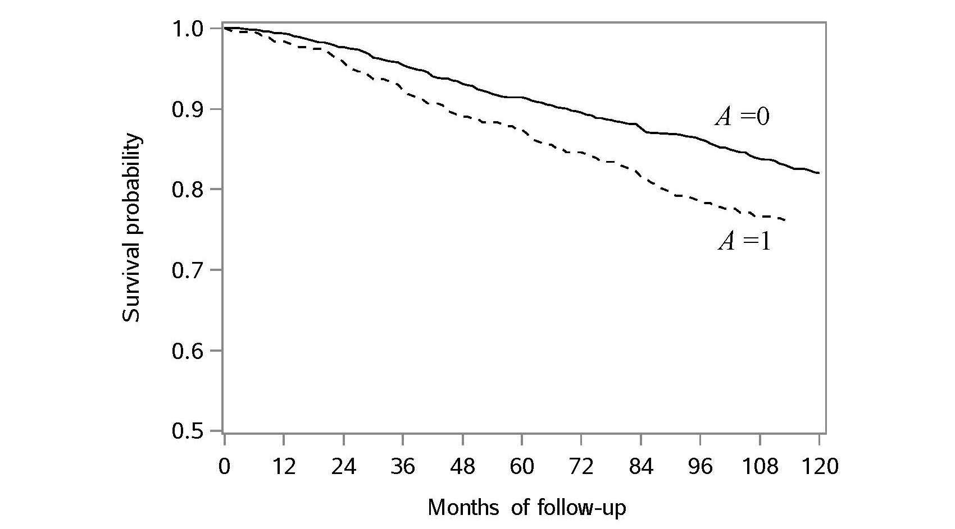
Standardized survival curves

Slide 102
Step #4: Estimation of variance 95% confidence interval
Again we can use “bootstrapping” to calculate an approximate 95% confidence interval of the difference of standardized survivals. Remember: The lazy statistician’s method
In our study, some 95% confidence intervals are
10-year survival under smoking cessation: 81.0% (76.4 to 84.9)
10-year survival under no smoking cessation: 82.2% (79.9 to 84.5)
Difference in 10-year survival: -1.2% (-7.0 to 3.7)

Slide 103
Goals for this talk
Explanation of the target trial framework
Example target trial emulation
Explanation of the g-formula
Calculation of the g-formula for multiple time-points
Simulation-based estimation of the parametric g-formula

Slide 104
How does it work?
Choose a population of interest and collect data
Estimate conditional likelihoods of life events
Simulate life histories under these conditional likelihoods using Monte-Carlo simulation
Estimate counterfactual outcome distributions from these simulated individuals under a set of perturbations on exposure
Murray et al, Am J Epidemiol 2017 ; 186(2): 131-142.

Slide 105



How does Monte-Carlo simulation work?
Baseline
Woman
Age 28
PANSS: 63
Time 1
Woman
Age 28+1/12
PANSS change: -2
Death probability = 0.5%
Alive
Notes:
Positive and Negative Syndrome Scale (range: 30-210)

Slide 106
Target trials are crucial for designing good simulations
What is the target population & does your data allow you to estimate effects in them?
What are the target interventions & do you have positivity for them in your data?
When would randomization happen? When does your data start? Can you reconcile these?
When does follow-up end? Does your data let you emulate the trial?

Slide 107
Goals for this talk
Explanation of the target trial framework
Example target trial emulation
Explanation of the g-formula
Calculation of the g-formula for multiple time-points
Simulation-based estimation of the parametric g-formula

Slide 108
Suggested Reading
Hernán & Robins 2020. Causal Inference: What If. Boca Raton: Chapman & Hall/CRC
https://www.hsph.harvard.edu/miguel-hernan/causal-inference-book/
Chapter 2: section 2.1-2.3
Chapter 13: Standardization and the parametric g-formula
Chapter 21: section 21.1

